Slide 1
Investigating Multimodal Features to Identify Multilingual Offense from Social Media Memes
Supervised By
Prof. Dr. Md Azad Hossain
Dept. of ETE, CUET.
Presented By
Eftekhar Hossain
ID No.: 19METE020P
Co- Supervised By
Prof. Dr. Mohammed Moshiul Hoque
Dept. of CSE, CUET.

Slide 2
Contents
Introduction
Challenges
Related work
Research Gap
Contributions
Task Definition
Proposed Methodology
Experiments and Results
Error Analysis
Conclusion

Slide 3
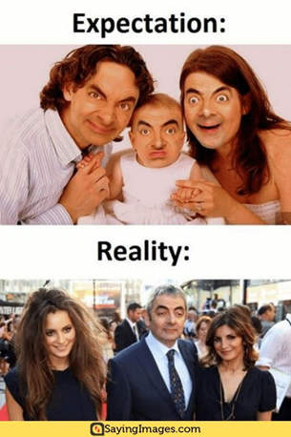
Introduction
Social Media Memes: an image or screenshot with some text embedded into it.
Memes can propagate information humorously or sarcastically.
Offensive Memes Classification: Task of assigning potential memes into predefined offensive categories.
Necessity,
Rise of offensive content in social media
Incite communal hate, spread distorted propaganda,
Damage social harmony
Ensure the quality of information ecosystem

Slide 4
Introduction (Cont.)
Impractical to manually monitor and moderate,
Massive volume
Time consuming
Frequency of information generation
Cost
Solution,
Develop automated systems to classify offensive memes
Develop NLP tools to tackle the spread of such undesired content
Prior studies focused on only textual modality to identify troll and offensive content.

Slide 5
Motivations
Major motivations,
Less studies have performed yet to identify the multimodal offensive content in multilingual scenario.
Such system is required to ensure the quality of conversations and security in the social space.
If we able to detect offensive meme it will help our law enforcement agencies.

Slide 6
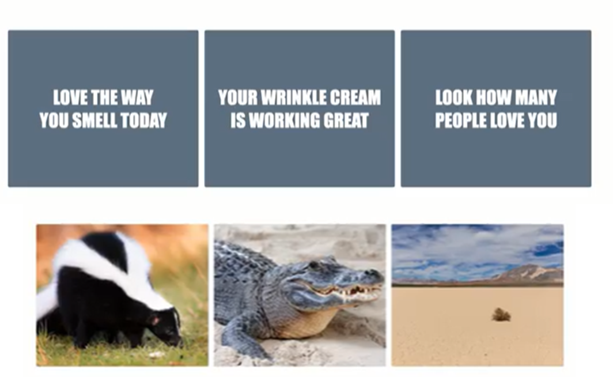
Challenges

Slide 7
Challenges (Cont.)

Slide 8
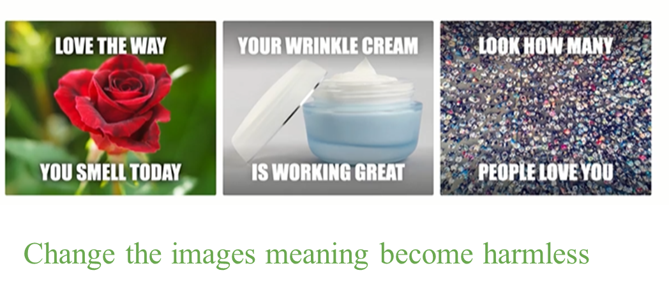
Challenges (Cont.)

Slide 9
Challenges (Cont.)
Key Barriers
Implicit nature
Multi-modality
Complicated structure
Issue of low-resource language
The contextual understanding of natural language
The presence of ambiguous, humorous, sarcastic terms, and
The absence of baseline methods and the prevalence of multilingual texts

Slide 10
Related Work (Image Based Methods)
Image matters: Detecting offensive and non-compliant content / logo in product images, (Gandhi et al., 2019)
Developed a system to detect and remove offensive content from an e-commerce catalog.
Pre-trained visual models are employed.
A dataset for troll classification of TamilMemes ( Suryawanshi et al., 2020)
Released a dataset containing troll memes in Tamil.
They used pre-trained (ResNet, MobileNet) image classification methods to differentiate between meme classes.
Smart content recognition from images using a mixture of convolutional neural networks (Connie et al., 2017)
Developed a CNN-based adult content recognition system.
Used a weighted sum of multiple CNNs

Slide 11
Related Work (Text Based Methods)
Deep learning based fusion approach for hate speech detection (Zhou et al., 2020)
Employed the deep learning-based fusion approach to identify hate
Their work applied CNN, BERT, and ELMo to extract the textual features
Offensive language detection from multilingual code-mixed text using transformers (Sharif et. al., 2021)
Showed that transformer-based models outdo ML and DL-based methods to detect multilingual offensive texts
Offensive language detection for Dravidian code-mixed YouTube comments (Andrew et al., 2021)
Performed experimentation with SVM, LR, RF, and KNN to
Their work did not consider any semantics and contextual features

Slide 12
Related Work (Multimodal Based Methods)
Multimodal hate speech detection in greek social media(Perifanos et al. 2021)
Developed a multimodal dataset considering hateful, xenophobic, and racist tweets.
They applied pre-trained Resnet and BERT models for extracting visual and textual features.
Multimodal meme dataset (MultiOFF) for identifying offensive content in image and text (Suryawanshi et al., 2020)
Built a multimodal dataset of 743 offensive and non-offensive memes related to the 2016 U.S. presidential election.
They adopted the early fusion approach to combine the multimodal features.
Exploring multimodal transformers for meme classification in Tamil language (Li et al. 2021)
Developed a multimodal model leveraging the pre-trained BERT and ResNet152 architectures.

Slide 13
Related Work (Multimodal Based Methods)
Investigating visual and textual features to identify trolls from multimodal social media memes (Hossain et al. 2021)
Put together image and text features using the late fusion approach.
In the multimodal approach, BiLSTM is employed to extract the textual features.

Slide 14
Existing Works Limitation
Considered only a single modality for offense or troll detection
Did not exploit the advanced techniques to extract the multimodal features
Incapable of capturing sequential features
Joint evaluation of the multimodal features has not explored
Did not consider the multilingual scenario.

Slide 15
Research Gap
The key research questions explored in this work are
RQ1: How to develop a framework leveraging features from visual and textual modalities to identify offense and trolling from memes?
RQ2: How to develop a unified architecture that can effectively work on multilingual multimodal memes?
RQ3: Can conventional ensemble methods be appropriate enough in offensive memes detection?
RQ4: Can zero-shot learning be applied in cross-domain settings for multimodal offense detection?

Slide 16
Contribution
Propose a model that exploits visual, textual, and multimodal features of the memes.
Investigate the multimodal decision fusion, and feature fusion approaches with contemporary visual and textual models.
Employ an ensemble technique that automatically assigns appropriate weight to the participating modules based on their prior performance on the dataset.

Slide 17
Contribution (Cont.)
Empirically evaluates the proposed model on multilingual (English & Tamil) datasets and demonstrates how ensemble technique can enhance the classifier’s performance.
Perform extensive experimentation and compare the performance with a set of visual, textual, and multimodal models.
Present a quantitative, qualitative analysis of the model’s miss-classifications and point out a few directions to resolve these issues.

Slide 18
Offensive Memes Detection Framework

Slide 19
Task Definition
The research objective is to develop a framework ($F$) to identify offense and trolling from memes.
The$F$analyzes a set of memes $M = \{m_{1},m_{2}…,m_{n}\}$and categorize them as offense/troll ($c = 1$) or not ($c = 0$).
Each meme $m_{i}$ consists of visual ($v$) and textual ($t$) information and the $F$ utilize this information to classify $m_{i}$ .
The task is represented as a mapping, $F : M(v,t) → c ε (0, 1$)

Slide 20
Dataset Description
Two benchmark datasets have been utilized to attain the goal:
English offensive meme or MultiOFF → Dataset-1 (D1)
Tamil troll meme or TamilMemes → Dataset-2 (D2)
The authors defined offense and troll as the following:
Offense: memes that spread an idea/emotion with the intention to demean social identity, harass targeted individuals, community or a minority group.
Troll: memes which contain offensive texts or images and intend to provoke, offend, abuse or insult individuals, group, or a race.

Slide 21
Dataset Description (Cont.)
Table 1. Number of instances in train, validation, and test set for each dataset

Slide 22
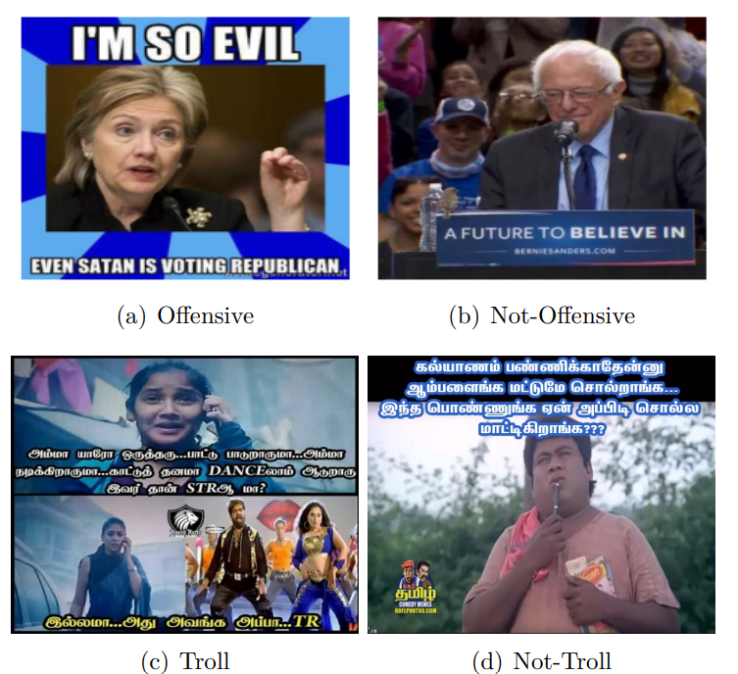
Dataset Description (Cont.)
Figure 1. Sample memes of each class: dataset-1 (a,b) and dataset-2 (c,d)

Slide 23
Dataset Analysis
Table 2. Training set statistics for textual content

Slide 24
Contribution 1
Development of Computational Models to Classify Offensive Memes

Slide 25
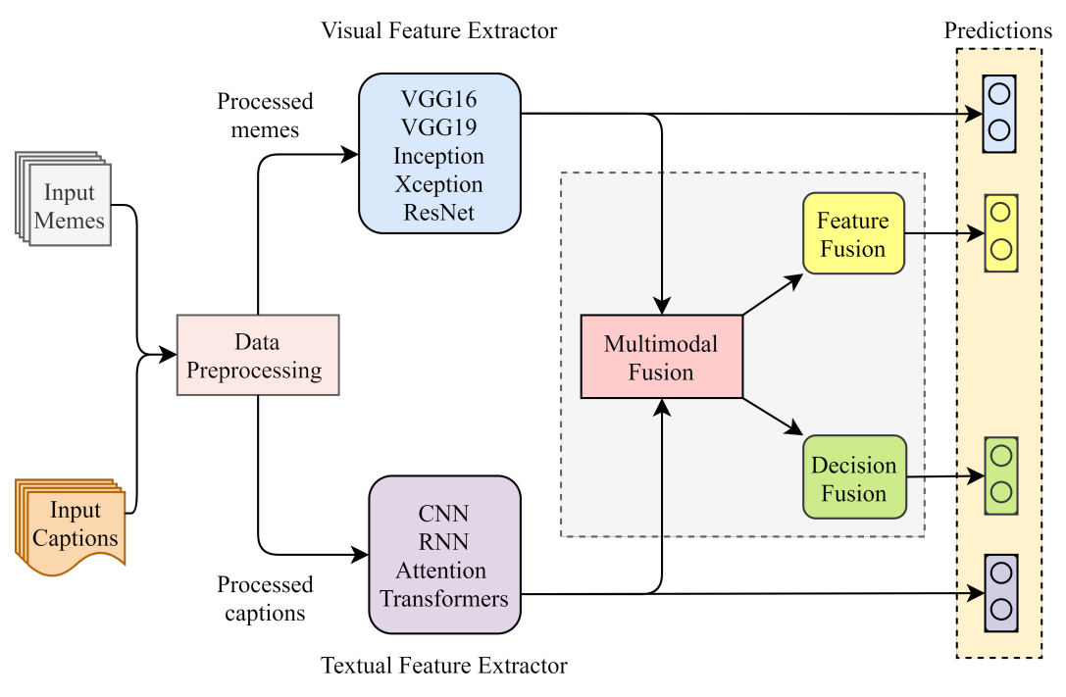
Methodology
Figure 2. Abstract view of multimodal offense and troll detection system.

Slide 26
Data Processing
For the visual modality,
Images are transformed into equal sizes of $150 × 150 × 3$
The normalization is performed over the pixel matrix
For the textual modality,
For DNN, the input texts are converted into a vector of unique numbers
The mapping of this word to the index is obtained using the Keras tokenizer function.
Post padding technique is adopted to get equal-length vectors.

Slide 27
Data Processing (Cont.)
For the Textual modality (Transformers),
The ‘encode_plus’ method is used to encode the inputs texts.
This method adds a special [CLS] and [SEP] token at the start and end of an input text.
It also converts the texts into a vector of unique ids and pad 0’s to shorter vectors than the maximum length.
Besides, an attention mask is enabled so that the model emphasizes the tokens having unique ids.
These ‘ids’ and ‘attention masks’ are given as input to the transformer models

Slide 28
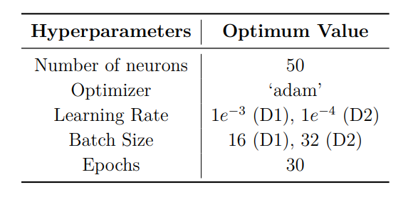
Visual Models
Visual features are extracted by using convolutional neural networks (CNN)
Transfer learning approach is employed in this work
Several pre-trained CNN architectures such as
VGG16, VGG19, ResNet50, InceptionV3, and Xception are considered
Table 4. Optimum hyperparameters value used for visual models

Slide 29
Textual Models
Various deep-learning architectures are implemented to obtain features from the textual content.
The primary investigation is carried out using RNN and CNN architectures,
BiLSTM,
BiLSTM with CNN, and
BiLSTM with attention
Word embedding features are used to train these models
Pretrained transformers are also exploited to develop cutting-edge models
Multilingual Bidirectional Encoder Representations for transformers (m-BERT),
Lighter version of BERT (m-DistilBERT),
Cross-lingual version of robustly optimized BERT (XLM-R)

Slide 30
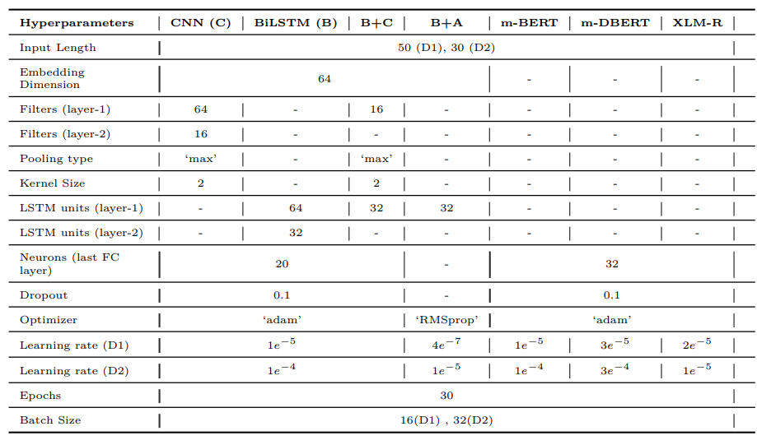
Textual Models (Cont.)
Table 5. Optimum hyperparameters value utilized for training the textual models.

Slide 31
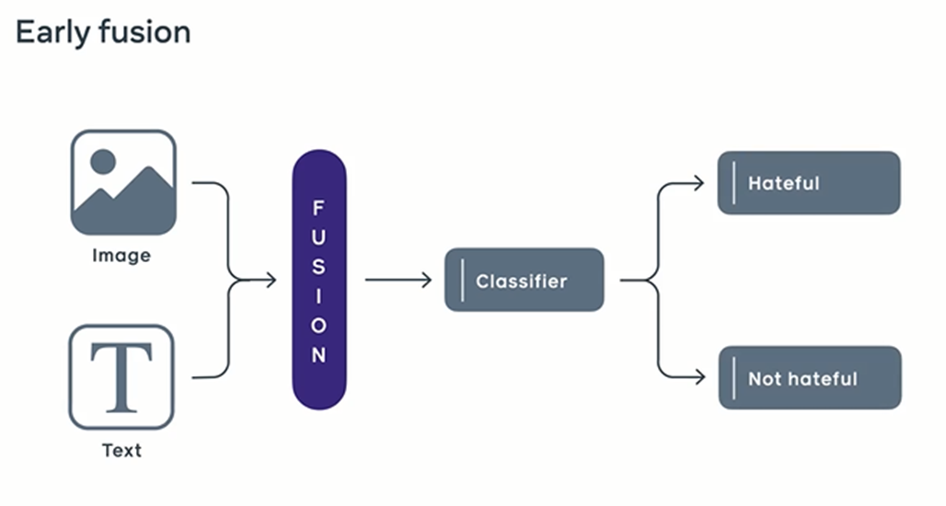
Multimodal Fusion
Offensive
Not-Offensive

Slide 32
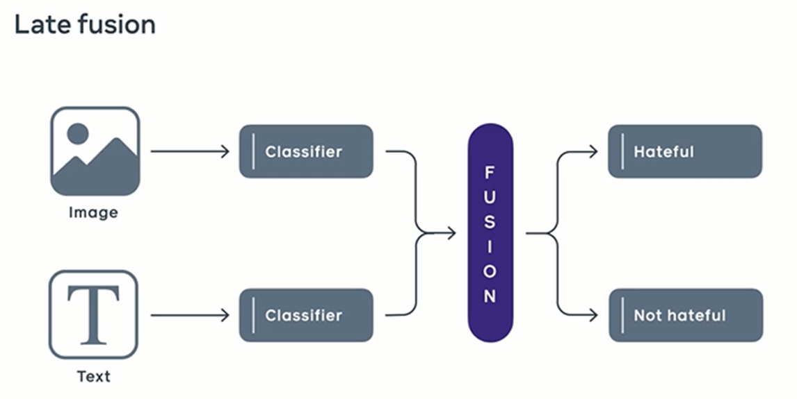
Multimodal Fusion (Cont.)
Offensive
Not-Offensive

Slide 33
Multimodal Fusion (Cont.)
This work applies both fusion approaches to develop computational models.
This work considers only the best three models from each modality for ease of analysis.
The best models are chosen based on their weighted f1-score on the validation set.

Slide 34
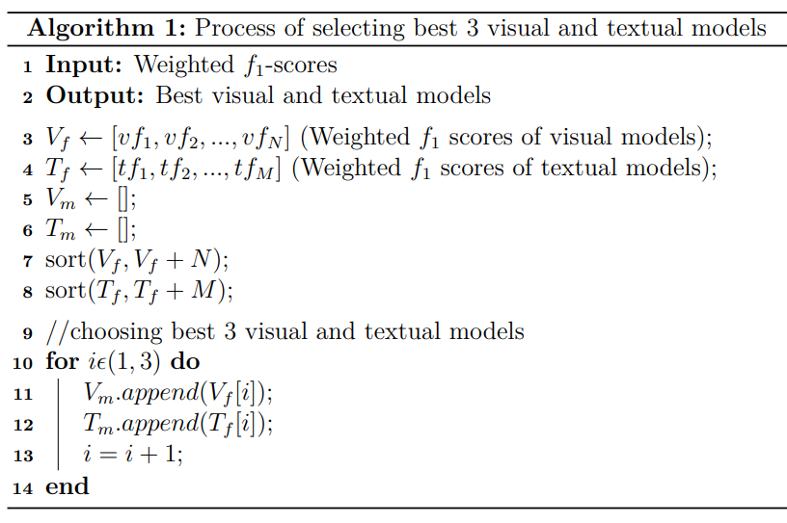
Multimodal Fusion (Cont.)
Empirical observations revealed that VGG16, VGG19, and ResNet50 are the best visual models,
whereas m-BERT, m-DistilBERT, and XLM-R are the best textual models.

Slide 35
Contribution 2
Proposed Weighted Ensemble Approach

Slide 36
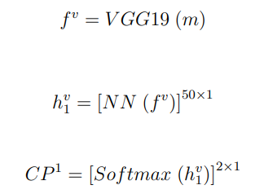
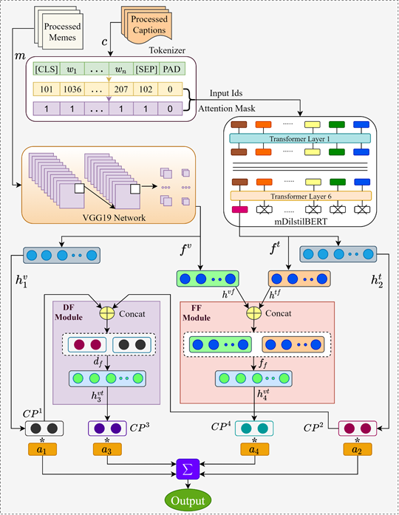
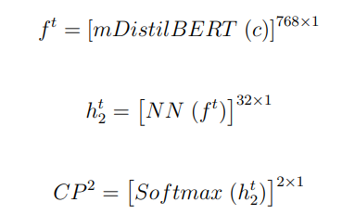
Proposed Method
Figure 4. Overall architecture of the proposed framework for offensive/troll meme identification

Slide 37
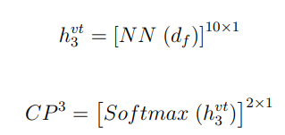
Proposed Method (Cont.)
Figure 4. Overall architecture of the proposed framework for offensive/troll meme identification

Slide 38
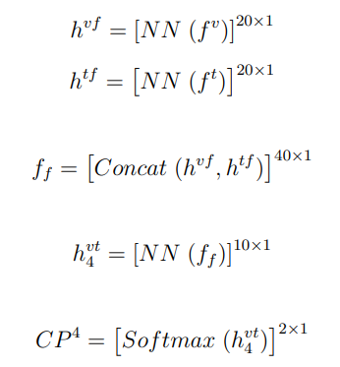
Proposed Method (Cont.)
Figure 4. Overall architecture of the proposed framework for offensive/troll meme identification

Slide 39
Proposed Method (Cont.)
Softmax Probabilities
Probability Aggregation
Weights
Output: Class with Max Prob
Normalization

Slide 40
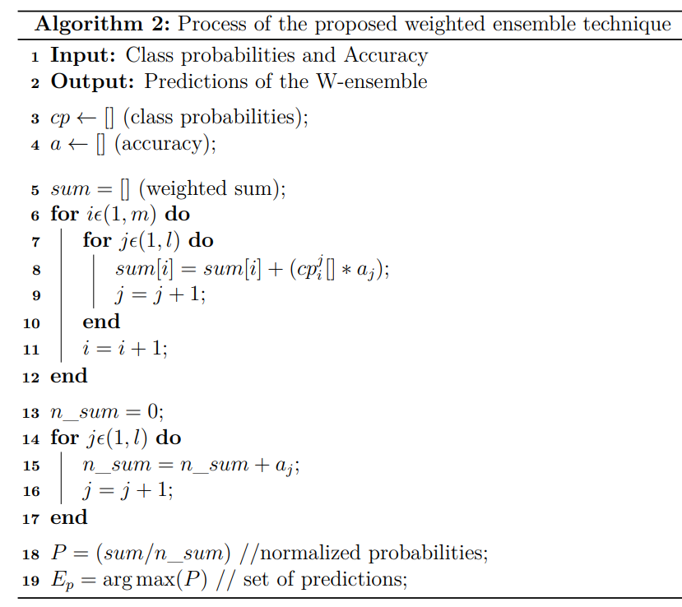
Proposed Method (Cont.)

Slide 41
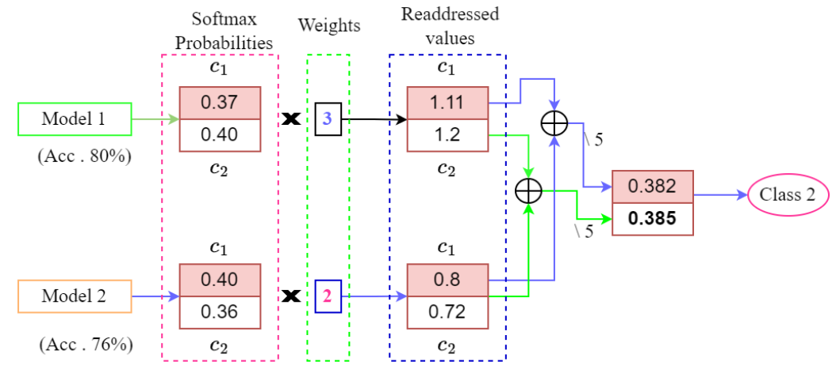
Proposed Method (Cont.)
Figure 5. Process of proposed weighted ensemble technique

Slide 42
Experiments and Results
Experimental Setup,
GPU facilitated Google Colab platform (12.5GB RAM,110GB disk space)
Pandas (1.1.4) and numpy (1.18.5) to process and prepare the data.
Deep learning model are trained using Keras (2.4.0) and TensorFlow (2.3.0)
Transformers are downloaded from Huggingface.

Slide 43
Experiments and Results
Measures of Evaluation,
Accuracy
Precision
Recall
Weighted F1-score
Weighted F1-score is used to determine the superiority of the models.

Slide 44
Experiments and Results (Unimodal Models Performance)
Table 6. Performance comparison of visual and textual models on test set .
VGG19 achieved the highest performance amidst the visual models
m-DistilBERT obtained highest outcome in case of the textual models

Slide 45
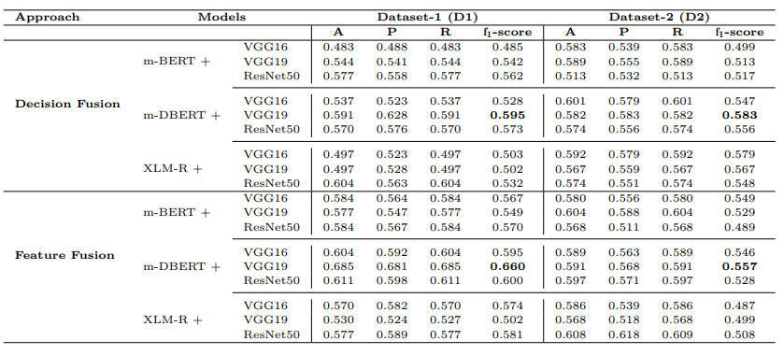
Experiments and Results (Multimodal Models Performance)
Table 7. Performance comparison of multimodal models on test set.

Slide 46
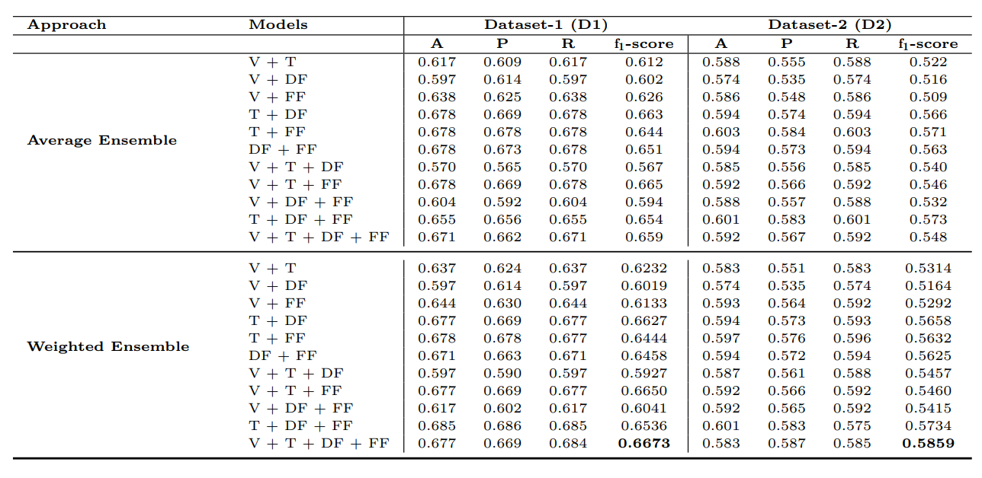
Experiments and Results (Ensemble Models Performance)
Table 8. Performance comparison of various models on test set utilizing the average and weighted ensemble method. Here, V, T, DF, and FF represent the best visual (VGG19), textual (m-distilBERT), decision fusion (VGG19 + m-distilBERT), and feature fusion (VGG19 + m-distilBERT) models respectively.

Slide 47
Experiments and Results
Insights,
VGG19 achieved the highest weighted f1-score among the visual models
m-distilBERT attained the maximum performance in textual models
A substantial increase in performance is observed when the visual and textual information is combined
Average ensemble of the models did not provide any consistent outcomes.
The proposed weighted ensemble method outperformed all the models in both datasets (D1 and D2)
The proposed method’s ability to emphasize the model’s SoftMax predictions based on their prior results

Slide 48
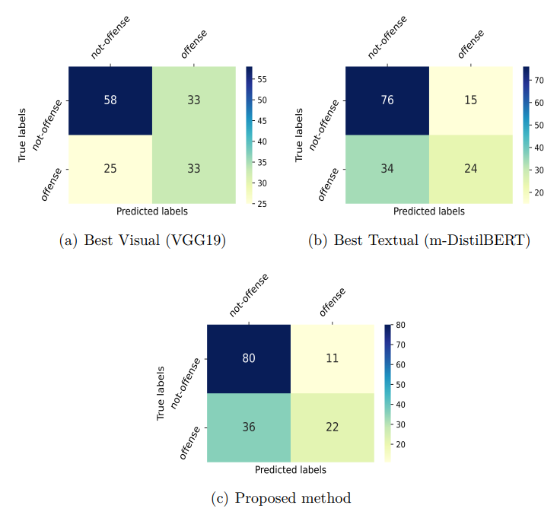
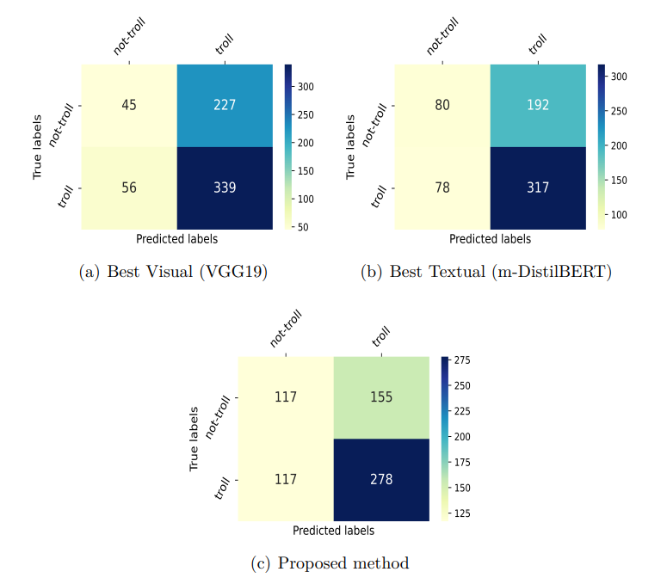
Experiments and Results (Error Analysis)
Figure 6. Confusion matrices of different models developed for dataset-1 (D1).
Figure 7. Confusion matrices of different models developed for dataset-1 (D2).

Slide 49
Experiments and Results (Error Analysis)
Findings,
The error also indicates that the best visual model (i.e., VGG19) is more appropriate in identifying the offense and troll classes.
There is a trade-off between individual class performance as when the error of one class decreased, the other’s class is increased.

Slide 50
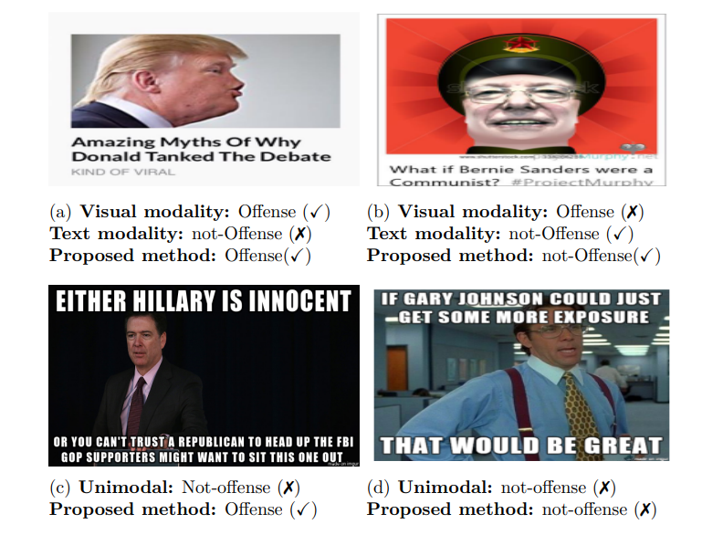
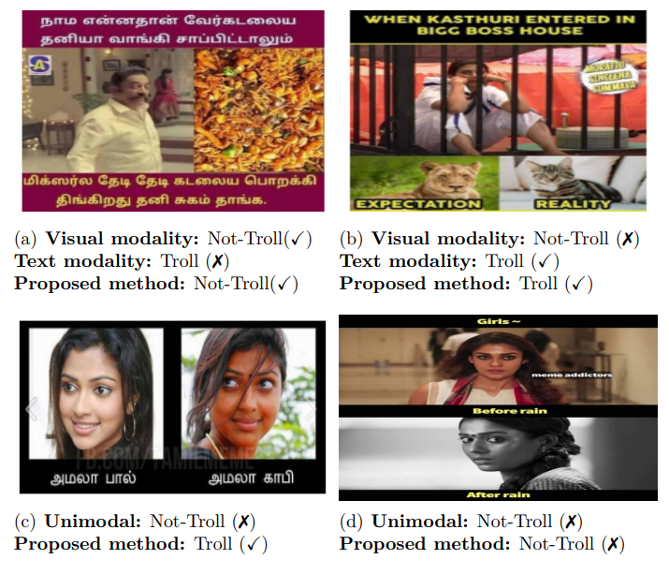
Experiments and Results (Error Analysis)
Figure 8. Few correctly and misclassified examples predicted by the proposed and other approaches on the dataset-1 (D1) and dataset-2 (D2). The symbol (✗) indicates an incorrect classification, and the symbol (✓) indicates a correct classification.

Slide 51
Experiments and Results
Findings,
Quantitative analysis revealed that the model’s performance becomes biased towards a particular class (i.e., not-offense/not-troll)
The possible reason for this incongruity might be due to
The extensive appearance of some strong words such as “Trump”, “Hilary”, “Bernie”, “Communist”, “Amala”, “Sayessha”, “boys”, “girls”, and “Anna” respectively in the textual content of the offense/not-offense and troll/not-troll classes of memes.

Slide 52
Experiments and Results
Findings,
In dataset-1, some world-famous person faces frequently appeared in the memes of both classes.
Dataset-2 also has plenty of memes with common person faces (i.e., south Indian actors) in troll and not-troll classes.
The presence of these consistent visual and textual features made it arduous for the models to differentiate the appropriate class.

Slide 53
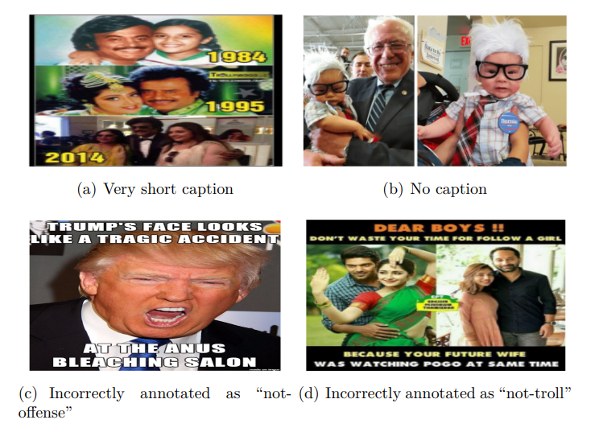
Experiments and Results
Other factors for performance degradation,
Figure 9. Few ambiguous and complicated memes from D1 and D2 illustrating why models failed to detect the actual label of memes

Slide 54
Experiments and Results
Cross domain Transfer
Aims at leveraging knowledge obtained from a source domain to train a high-performance learner for offense detection on a target domain
Tries to investigate that what extent one dataset performance can benefit from another dataset
Can be done in both zero-shot and few-shot settings
We examine cross-domain transfer by fine-tuning the proposed model on a source domain (D1 or D2) and evaluating on a target domain.
The performance can be measured by relative zero-shot transfer ability

Slide 55
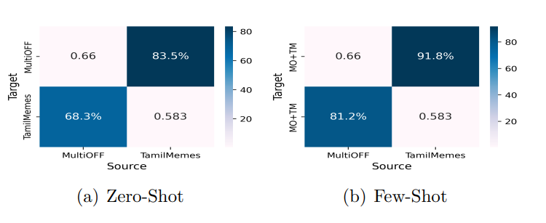
Experiments and Results
Cross domain Transfer
Figure 10. Cross domain transfer performance on the two datasets

Slide 56
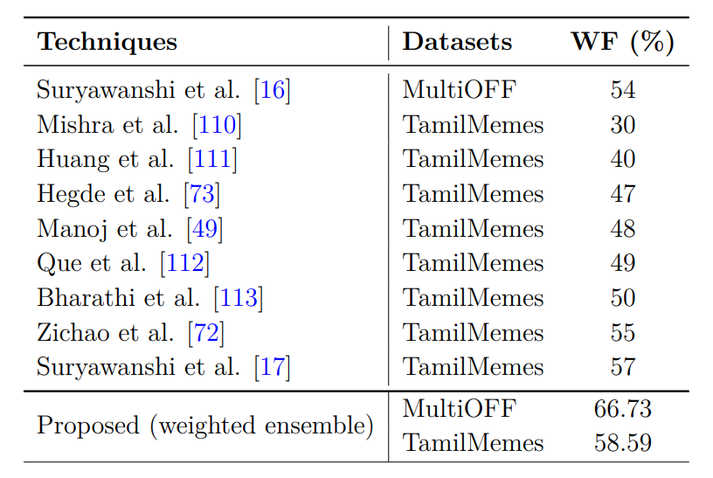
Experiments and Results (Comparison With Existing Methods)
Table 9. Comparative analysis of the proposed method with the existing state of-the-art techniques. MultiOFF and TamilMemes indicates the dataset-1 (D1) and dataset-2 (D2)
The proposed method achieved the best weighted f1 score of 66.73% (≈ 13% ↑) as compared to the weighted f1 score of 54% of the baseline model (i.e., Suryawanshi et al. [16]) for “MultiOFF” dataset (D1).
For the “TamilMemes” dataset (D2), the proposed model gained the highest weighted f1 score of 58.59%(1.59% ↑) as compared to the outcome of the model developed by Suryawanshi et al. [17])

Slide 57
Conclusion
This work investigated various state-of-the-art visual, textual and multimodal models.
Proposes a weighted ensemble-based technique that can effectively learn from all types of features.
The experimented results revealed that the proposed technique outdoes all the models by obtaining the highest weighted f1 score of 66.73% (MultiOFF dataset) and 58.59% (TamilMemes dataset), respectively.
The proposed technique outcomes are approximately 13% (in ‘MultiOFF’) and 1.69% (in ‘TamilMemes’) ahead compared to the current state-of-the-art systems.

Slide 58
Future Directions
Aim to explore visual attention and transformer architectures
Will be interesting to investigate how this problem can be tackled utilizing the multitask learning approach
Can be investigated with different language datasets such as Bengali, Portuguese, and Greek.
Develop a web-based system that can filter different online posted memes which are offensive in nature

Slide 59
Related Publications
The following publication is a direct consequence of the research carried out during the elaboration of the thesis and gives an idea of the progression that has been achieved.
Hossain, E., Sharif, O. and Hoque, M.M. and Dewan, M.A.A and Siddique, N. & Hossain, Md Azad., “Identification of Multilingual Offense and Troll from Social Media Memes Using Weighted Ensemble of Multimodal Features”, Journal of King Saud University-Computer and Information Sciences, Elsevier (Q1, IF = 8.834), 2022.
Hossain, E., Hoque, M.M., & Hossain, Md Azad., “An Inter-modal Attention Framework for Multimodal Offense Detection”, Proceedings of the 5th International Conference on Intelligent Computing and Optimization, 2022 (ICO2022), Springer.

Slide 60
References
J. Pavlopoulos, N. Thain, L. Dixon, and I. Androutsopoulos, “ConvAI at SemEval-2019 task 6: Offensive language identification and categorization with perspective and BERT,” in Proceedings of the 13th International Workshop on Semantic Evaluation, (Minneapolis, Minnesota, USA), pp. 571–576, Association for Computational Linguistics, June 2019.
M. Zampieri, P. Nakov, S. Rosenthal, P. Atanasova, G. Karadzhov, H. Mubarak, L. Derczynski, Z. Pitenis, and Ç. Çöltekin, “SemEval-2020 task 12: Multilingual offensive language identification in social media (OffensEval 2020),” in Proceedings of the Fourteenth Workshop on Semantic Evaluation, (Barcelona (online)), pp. 1425–1447, International Committee for Computational Linguistics, Dec. 2020.
J. Drakett, B. Rickett, K. Day, and K. Milnes, “Old jokes, new media–online sexism and constructions of gender in internet memes,” Feminism & Psychology, vol. 28, no. 1, pp. 109–127, 2018.
S. Suryawanshi, B. R. Chakravarthi, M. Arcan, and P. Buitelaar, “Multimodal meme dataset (MultiOFF) for identifying offensive content in image and text,” in Proceedings of the Second Workshop on Trolling, Aggression and Cyberbullying, (Marseille, France), pp. 32–41, European Language Resources Association (ELRA), May 2020.
S. Suryawanshi, B. R. Chakravarthi, P. Verma, M. Arcan, J. P. McCrae, and P. Buitelaar, “A dataset for troll classification of TamilMemes,” in Proceedings of the WILDRE5– 5th Workshop on Indian Language Data: Resources and Evaluation, (Marseille, France), pp. 7–13, European Language Resources Association (ELRA), May 2020

Slide 61
References
L. G. Mojica de la Vega and V. Ng, “Modeling trolling in social media conversations,” in Proceedings of the Eleventh International Conference on Language Resources and Evaluation (LREC 2018), (Miyazaki, Japan), European Language Resources Association (ELRA), May 2018.
K. Perifanos and D. Goutsos, “Multimodal hate speech detection in greek social media,” in Preprints, 2021.
K. Kumari, J. P. Singh, Y. K. Dwivedi, and N. P. Rana, “Multi-modal aggression identification using convolutional neural network and binary particle swarm optimization,” Future Generation Computer Systems, vol. 118, pp. 187–197, 2021.
R. Gomez, J. Gibert, L. Gomez, and D. Karatzas, “Exploring hate speech detection in multimodal publications,” in Proceedings of the IEEE/CVF Winter Conference on Applications of Computer Vision (WACV), March 2020.
E. Hossain, O. Sharif, and M. M. Hoque, “NLP-CUET@DravidianLangTechEACL2021: Investigating visual and textual features to identify trolls from multimodal social media memes,” in Proceedings of the First Workshop on Speech and Language Technologies for Dravidian Languages, (Kyiv), pp. 300–306, Association for Computational Linguistics, Apr. 2021.
S. Wang, J. Liu, X. Ouyang, and Y. Sun, “Galileo at SemEval-2020 task 12: Multi-lingual learning for offensive language identification using pre-trained language models,” in Proceedings of the Fourteenth Workshop on Semantic Evaluation, (Barcelona (online)), pp. 1448–1455, International Committee for Computational Linguistics, Dec. 2020.

Slide 62
Q & A

